Slide 1
DIGITAL PORTFOLIO
STUDENT NAME : ABINAYA
REGISTER NO AND NMID : 24131061805222001
59F36077A32C134AAD14B3DCF4809480
DEPARTMENT : B.SC,DATA SCIENCE
COLLEGE : SHREE RAGHAVENDRA ARTS AND SCIENCE
COLLEGE,KEEZHAMOONGILADI.
AFFILIATED TO ANNAMALAI UNIVERSITY,
CHIDAMBARAM.

Slide 2
PROJECT TITLE
DIGITAL PORTFOLIO
A digital portfolio is an online collection of a person's work, achievements, skills, and experiences. It showcases projects, resumes, certificates, and other professional artifacts, often used for job applications, college admissions, or personal branding.

Slide 3
AGENDA
1. Problem Statement
2. project overview
3. End users
4.Tools and Technologies
5.portfolio design and layout
6.Features and Functionality
7.Results and Screenshots
8. Conclusion
9.Github Link

Slide 4
PROBLEM STATEMENT
To design and develop a personal digital portfolio website that showcases an profile , education , skills , achievements , projects and contact information in a simple and responsive manner.
The Portfolio should:
Provide smooth navigation across sections like Home , About , Skills , Education , and contact. Present information clearly with an attractive layout. Work on both mobile and desktop devices.

Slide 5
PROJECT OVERVIEW
1.Project Title : Personal Digital Portfolio by Priyadharshini. J
Data science Student
2. Objective : To design and develop a responsive portfolio website to showcase academic background, skills, and contact details professionally. Project Overview –
Digital Portfolio Website.
3.Key Features : Navigation Bar – Links to Home, About, Skills, Education, and Contact sections.
Hero Section – Displays name, title, location, and social links.
About Section – Overview of education and career interests.
Skills Section – Programming skills in Python, html , css and js
Education Section – Academic details and learning focus.
Contact Form – Allows visitors to get in touch via email.
Responsive Design – Compatible with mobile and desktop devices.

Slide 6
PROJECT OVERVIEW
4. Technologies Used :
HTML5 – Structure of the website.
CSS3 – Styling and layout design.Font Awesome – Icons for
visual enhancement.
JavaScript – Interactive features (toggle menu, contact form).
5. Expected Outcome :
A professional-looking personal portfolio website that highlights academic and career achievements, helping in internships, job applications, and professional networking.

Slide 7
END USERS
1.Potential Employers / Recruiters
• To review your skills, education, and contact information for internships or job opportunities.
2. College Faculty / Academic Evaluators
• To assess your project work, presentation, and technical knowledge.
3. Peers / Collaborators
• Fellow students, developers, or friends who may want to
collaborate on projects.
4. General Visitors
• Anyone interested in learning about your background, skills, and academic journey.

Slide 8
TOOLS AND TECHNOLOGIES
Tools Used
HTML5 – Structure and content of the website.
CSS3 – Styling, layout, and visual design.
Font Awesome – Icons for navigation and sections.
JavaScript – Interactivity (menu toggle, form handling).
Code Editor(codepen/ easy coder web)– For writing and edit Chrome code.
Web Browser(Chrome)– For testing and running the website.

Slide 9
TOOLS AND TECHNOLOGIES
Techniques Used
Responsive Web Design (RWD) – Ensuring website works on mobile, tablet, and desktop. Navigation
Bar Design – Smooth section linking for user-friendly experience.
Section-Based Layout – Dividing content into Hero, About, Skills, Education, and Contact sections.
Form Handling Technique – Collecting user input in
the contact form.
Use of External Libraries – Font Awesome for

Slide 10
PORTFOLIO DESIGN AND LAYOUT
Design
Minimal & Professional Look – Clean and simple interface with a focus on content.
Font Awesome Icons– For visual appeal and navigation clarity.
Color Scheme – Soft background with readable text contrast.
Typography – Clear headings and readable body text.
Layout
Navigation bar– Fixed menu with Home, About, Skills, Education, and Contact sections.
Hero Section – Name, title, location, and quick action buttons (LinkedIn,
Contact).
About Section – Personal introduction and highlights (Education Focus,
Interests, Goals).
Skills Section – List of technical skills (Python, html , css , js)
Education Section – Details of academic background and highlights.
Contact Section – Contact details, social links, and message form.
.

Slide 11
FEATURES AND FUNCTIONALTY
Features
1.Responsive Design – Works on desktop, tablet, and mobile.
2. Navigation Bar – Easy access to all sections (Home, About, Skills, Education, Contact).
3.Hero Section – Profile name, title, and location displayed prominently.
4. Interactive Buttons – LinkedIn and contact links open directly.
5. Font Awesome Icons – For better visual representation of sections.
6. Contact Form – Users can send messages directly.
7. Footer – Displays copyright and basic information.

Slide 12
FEATURES AND FUNCTIONALITY
Functionality
Smooth Scrolling between sections using navigation links.
Clickable Social Media Buttons to redirect to LinkedIn.
Form Submission to collect visitor messages (can be linked to email or
database in future).
Mobile-Friendly Layout ensuring proper alignment across all devices.

Slide 13
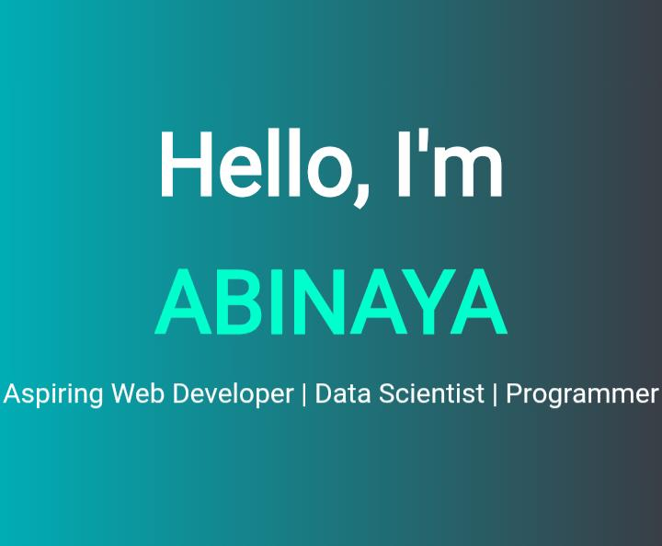
RESULTS AND SCREENSHOTS
Homepage-Showing name , title and
avatar.

Slide 14
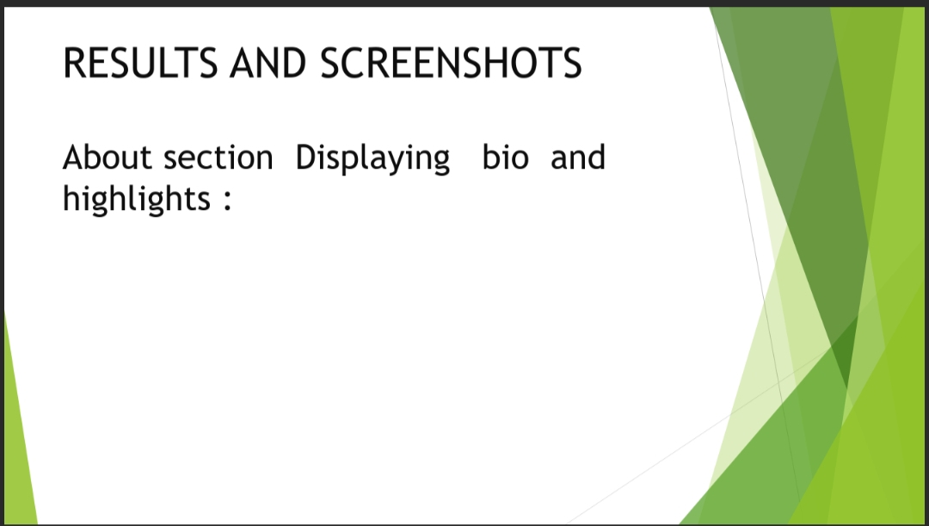
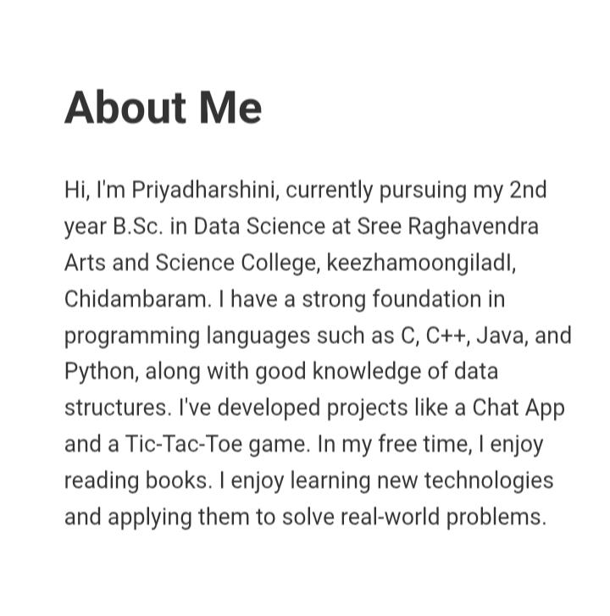
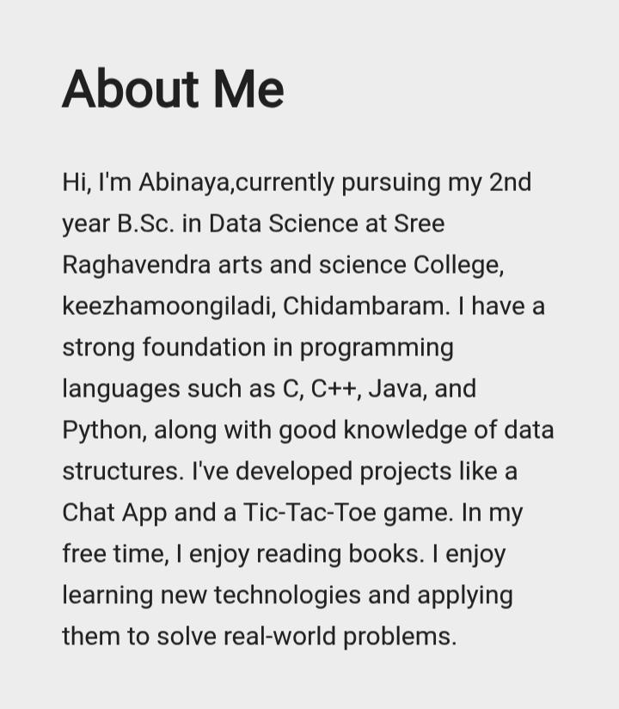

Slide 15
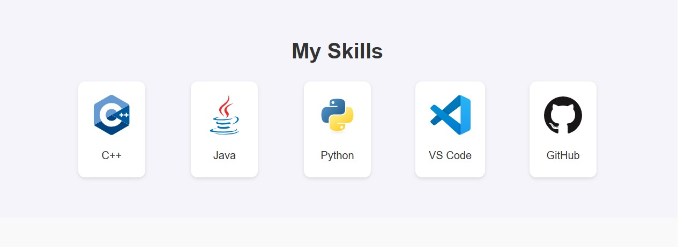
RESULTS AND SCREENSHOTS
Skills Section-Listing programming
Languages:

Slide 16
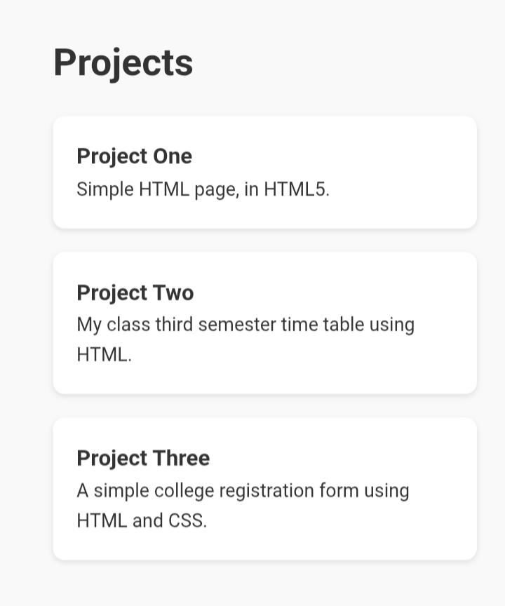
RESULTS AND SCREENSHOTS
Contact section-Email ,LinkedIn ,
And contact form:

Slide 17
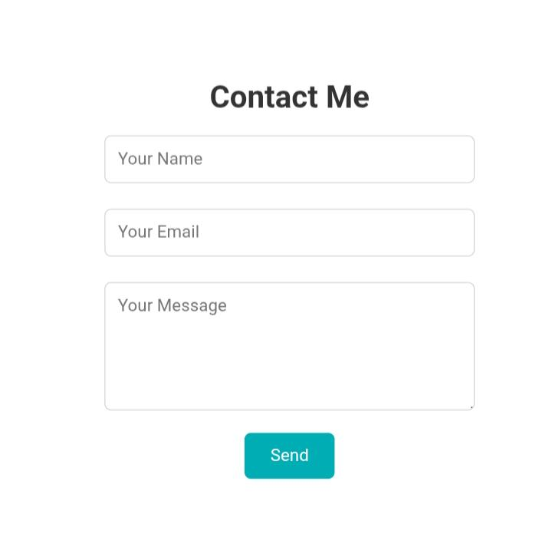

Slide 18
CONCLUSION
“The Digital Portfolio effectively showcases my personal profile , academic background, technical skills, and career aspirations in an organized and visually appealing format. It serves as a professional platform for potential employers, faculty, and collaborators to learn about my abilities and achievements. The project demonstrates my knowledge of web development using HTML, CSS, and JavaScript and highlights my capability to create user-friendly and responsive designs.”
“THANK YOU”

